Slide 1

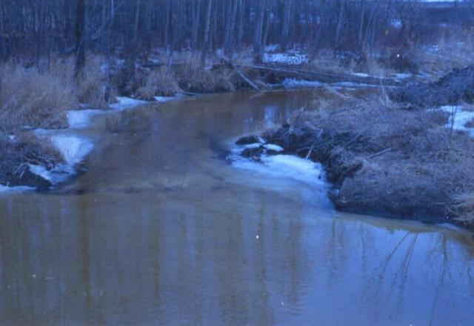
Protecting Source Water: The First Step in the Production of Safe Drinking Water

Slide 2
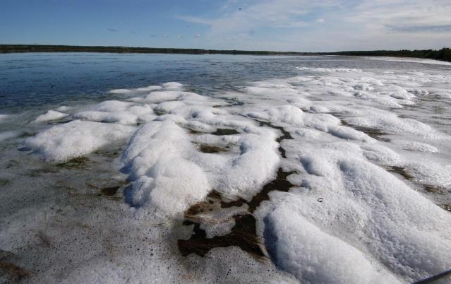
The First Step is Protecting Source Water
"The first barrier to the contamination of drinking water
involves protecting the sources of drinking water."
- Justice Dennis O'Connor, Walkerton Inquiry 2002

Slide 3

Pure Water Does Not Exist in the Natural Environment
Water is always found in combination with minerals and chemicals of one kind or another.
Sometimes these compounds are present naturally; other times they are present as a result of human activity.

Slide 4
Some Naturally Present Contaminants Have the Potential to Cause Harm to Humans
Metals (ex: arsenic, mercury and lead)
Radioactive compounds (ex: radium)
Microorganisms (ex: parasites, bacteria, protozoa, toxic blue-green algae)

Slide 5
Water can Become Contaminated with these Compounds and Microorganisms
If they are naturally present in the surrounding soil or rock
As a result of human activity (agriculture, industrial activity and urban development all affect the quality and quantity of surface water and ground water sources)

Slide 6
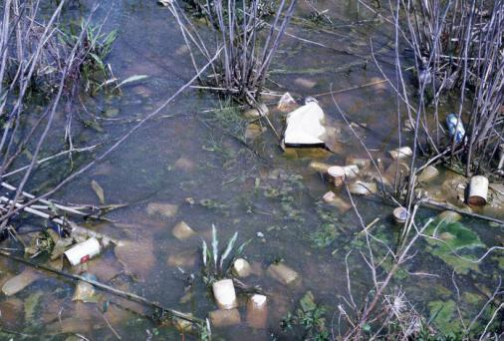
Lack of Regulations in First Nation Communities
Lacking any real regulations in First Nation communities, whatever is dumped in an unsafe manner may eventually get into the water source.

Slide 7
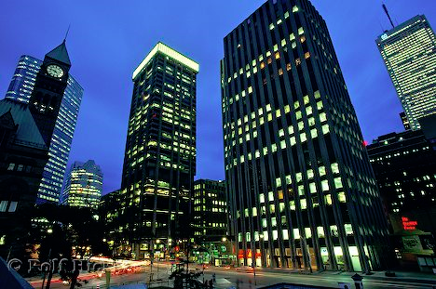
Surface Runoff
Some land-use activities, such as urban development, decrease the surface area available for water to filter into the ground. As a result, water simply flows across the land’s surface (called “surface runoff”) instead of recharging ground water.
Source: http://www.hickerphoto.com/toronto-skyscrapers-ontario-canada-9552-pictures.htm

Slide 8
Two Types of Surface and Ground Water Contamination
Point source pollution
Enters the environment at a specific place from an identifiable source
Some examples of point source pollution include:
  Industrial plant discharges, as well as spills and leaks of industrial chemicals
  Municipal wastewater effluents
  Landfill site leachate
  Wastes from existing and abandoned mining sites
  On-site septic systems
  Leaking underground oil and gas storage tanks

Slide 9
Two Types of Surface and Ground Water Contamination
Non-point source pollution
Comes from many diffuse sources
Caused when water that runs over land picks up natural and human-made pollutants and deposits these pollutants directly into surface waters, or into ground water through percolation

Slide 10
Two Types of Surface and Ground Water Contamination
Some examples of non-point source pollution include:
  Agricultural runoff, which can contain oil, grease, fertilizers, pesticides, bacteria and nutrients from livestock and manure
  Urban runoff from buildings, streets and sidewalks that carry sediment, nutrients, bacteria, oil, metals, chemicals, pesticides, road salts, pet droppings and litter
  Bacterial and petroleum products from recreational boating
  Saltwater intrusion
  Acid precipitation and other forms of air pollution that fall into surface waters and onto the land

Slide 11
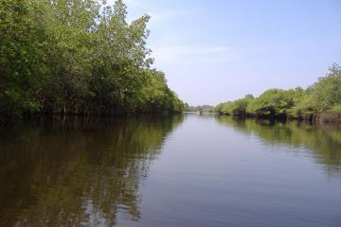
Preventing Contaminants From Entering Water Sources
An effective way to help ensure clean drinking water for people and keep them safe from waterborne diseases.

Slide 12
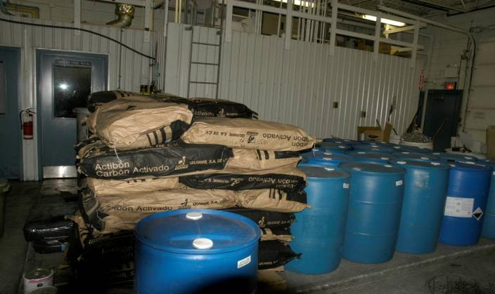
Conventional Water Treatment
There are many hazardous chemicals that conventional water treatment methods cannot effectively remove.

Slide 13
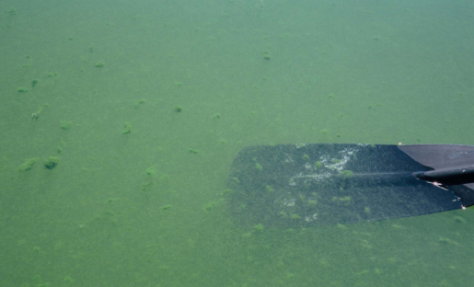
First Nation and Rural Communities
While source water protection works to everyone’s benefit, it is of particular concern for rural and First Nation consumers who typically do not have the same resources as urban centres. These are the communities who struggle the most when they are forced to treat poor quality source water.
Many native communities have to treat very poor quality raw water sources. Without proper treatment processes, no amount of training and regulations can make these waters safe to drink.

Slide 14
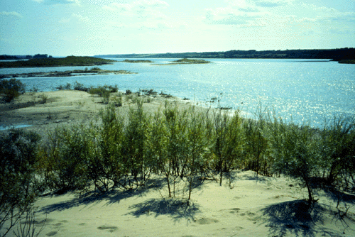
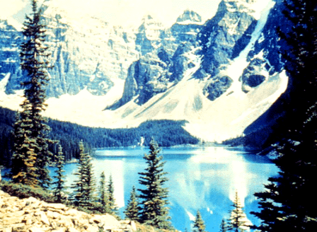
Source Waters for Cities

Slide 15
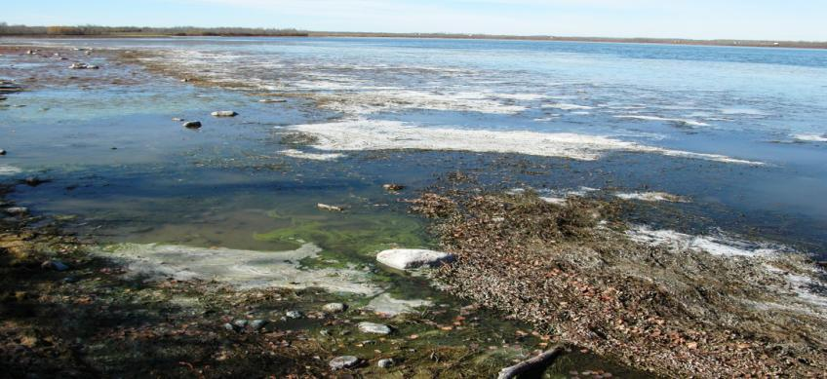
Source Water for Aboriginal Communities
Saddle Lake First Nation Raw Water, Dissolved Organics (DOC)

Slide 16
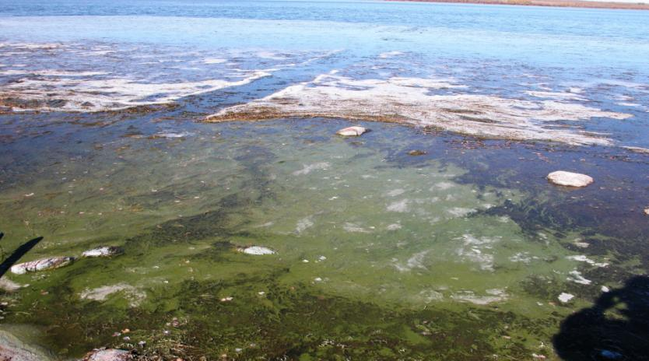
Saddle Lake Source Water Close-up, Note Canoe Trail that was 1.5 Hours Old

Slide 17
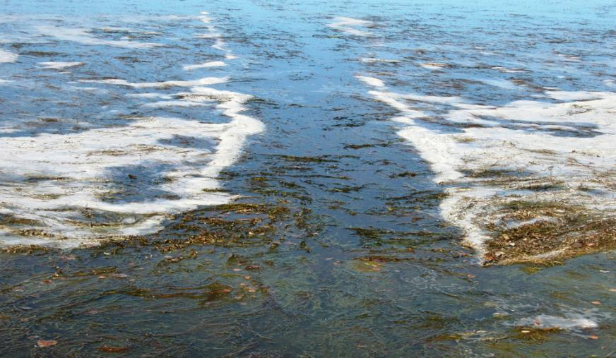
Canoe Trail

Slide 18
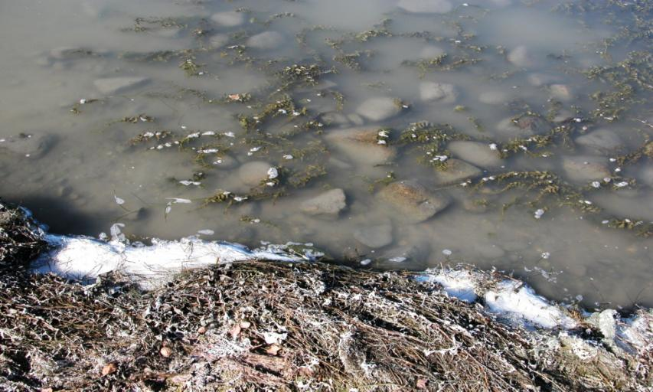
Anaerobic Surface Water

Slide 19
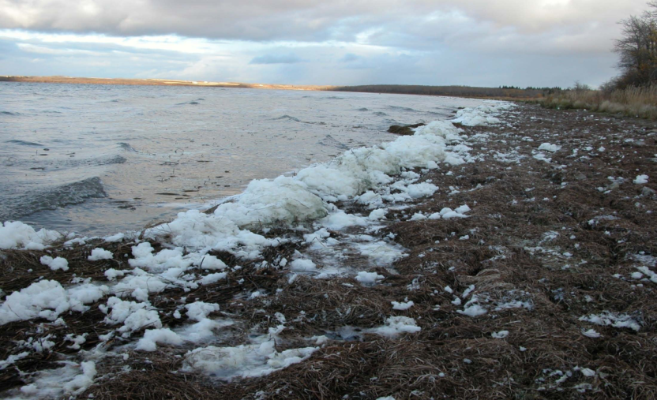
Windy Day by the WTP

Slide 20
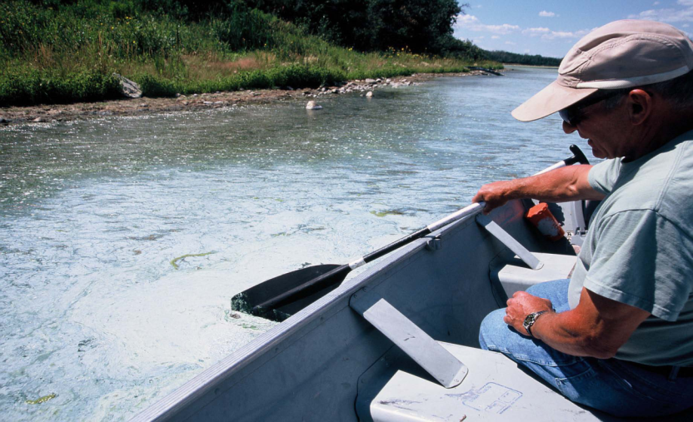

Slide 21
The Case of Saddle Lake and Dissolved Organics
Breakdown of plant and soil material:
Causes water to be coloured
Consumes chlorine
Inhibits disinfection
Forms disinfection by-products
“Disinfection is only effective when applied to good quality water.” – Degremont, 1991

Slide 22
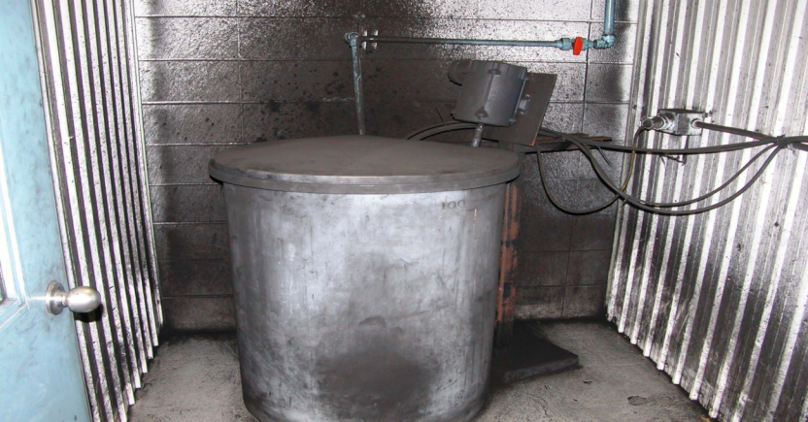
Combating Saddle Lake’s Water-Powdered Activated Carbon –Need Explosion Proof Room!!!!

Slide 23

The Case of Yellow Quill First Nation Source Water
A sewage tainted creek that only flowed between 5 and 14 days each spring

Slide 24
Yellow Quill’s Raw Water
Compromised by wastewater from a nearby non-native town
Extreme levels of particles, >100,000/mL in treated water, levels should be less than 100/mL
Extremely challenging chemistry as well

Slide 25
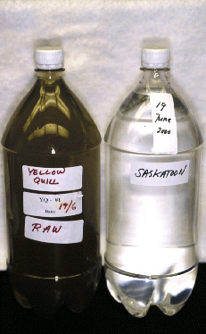
Aboriginal Raw Water (left) and Urban Raw Water (right)
This Aboriginal raw water on the left (from Yellow Quill) will undergo 5 minutes of treatment before it is drunk
This urban raw water on the right (from Saskatoon) will undergo 2 hours of treatment before it is drunk

Slide 26
Cost of Remediating Ground Water
According to the US Environmental Protection Agency, remediating ground water can be 40 times more expensive than taking steps to protect the water at the source.
Preventing contamination at the source also reduces the costs of treating water later in the drinking water treatment process.

Slide 27
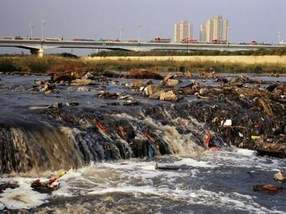
Future Water Shortages?
The United Nations warns that if current trends of wasting and polluting freshwater continue, two out of every three people on Earth will suffer moderate to severe water shortages in little more than two decades. It is imperative that we take measures to protect water sources today.
Source: http://environment.nationalgeographic.com/environment/photos/freshwater-threatened.html#1047_600x450.jpg

Slide 28
Human Activities Affecting Source Water
Source: www.groundwater.org

Slide 29
What Can Be Done About the Problems?
Stricter regulations
Enforcement of regulations
Public awareness
What do you think can/should be done? What problems do you see in your community? What are you going to do about these problems?

Slide 30


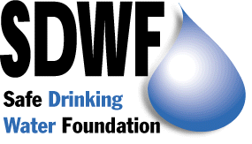
SDWF Mission
Encourage the universality of safe drinking water by supporting innovative research and development.
Increase awareness of health concerns from consumption of poor quality water.
Act as a policy advocate to ensure appropriate action is taken to provide safe drinking water to all people.

Slide 31
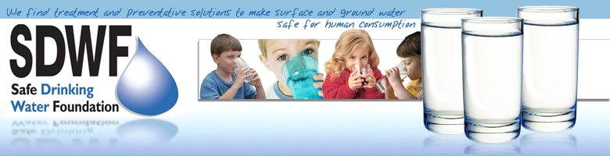
Please visit us at:
www.safewater.org

